Slide 1
ME781 Project
Data Counsel
~ Team 20
Arpit Saxena - 180040019
Utkarsh Sahu - 180100120
Vinut Raibagi - 203100056
Ashish Kumar - 213370007
Arpit Tiwari - 190110011

Slide 2
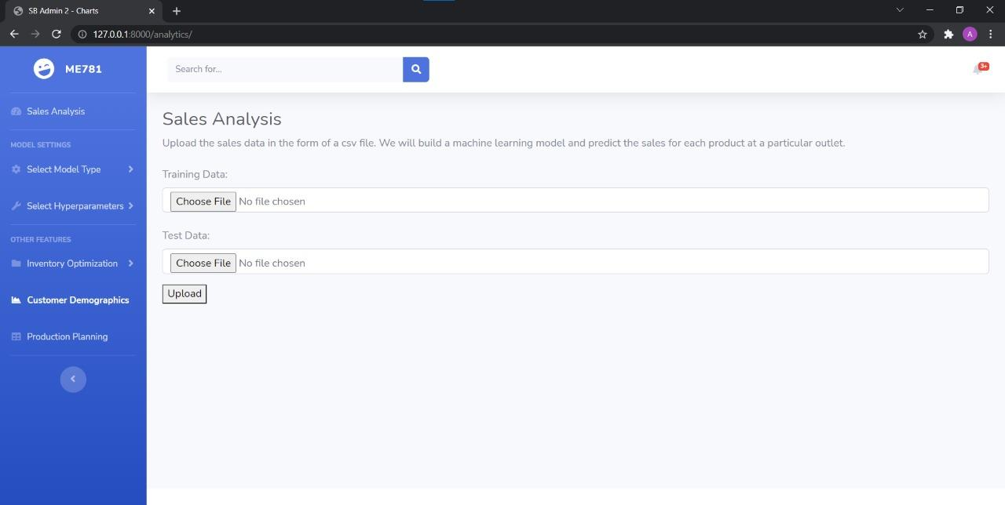
Product Demonstration
Select Model Type and Hyperparameters(*)
* : To be implemented

Slide 3
Product Demonstration
Other features like Inventory Optimiz. , Demographics & Production Planning (*)
* : To be implemented

Slide 4
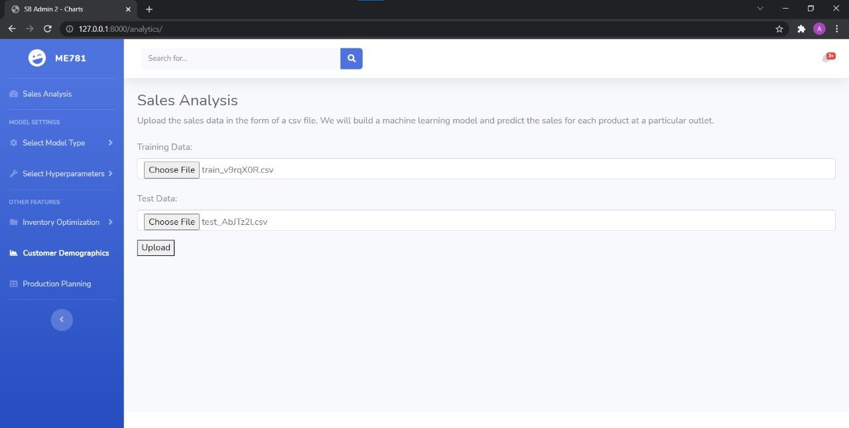
Product Demonstration
Upload Training and
Testing Files. Files should follow rules mentioned in Manual
Click on Upload

Slide 5
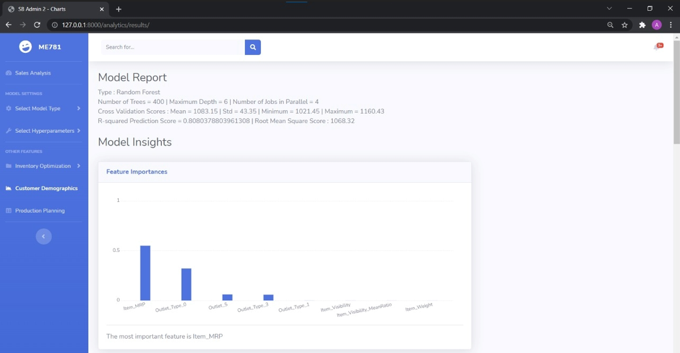
Product Demonstration
Model Report showing model settings & performance

Slide 6
Product Demonstration
Insights generated i) Feature Importances sorted in descending order

Slide 7
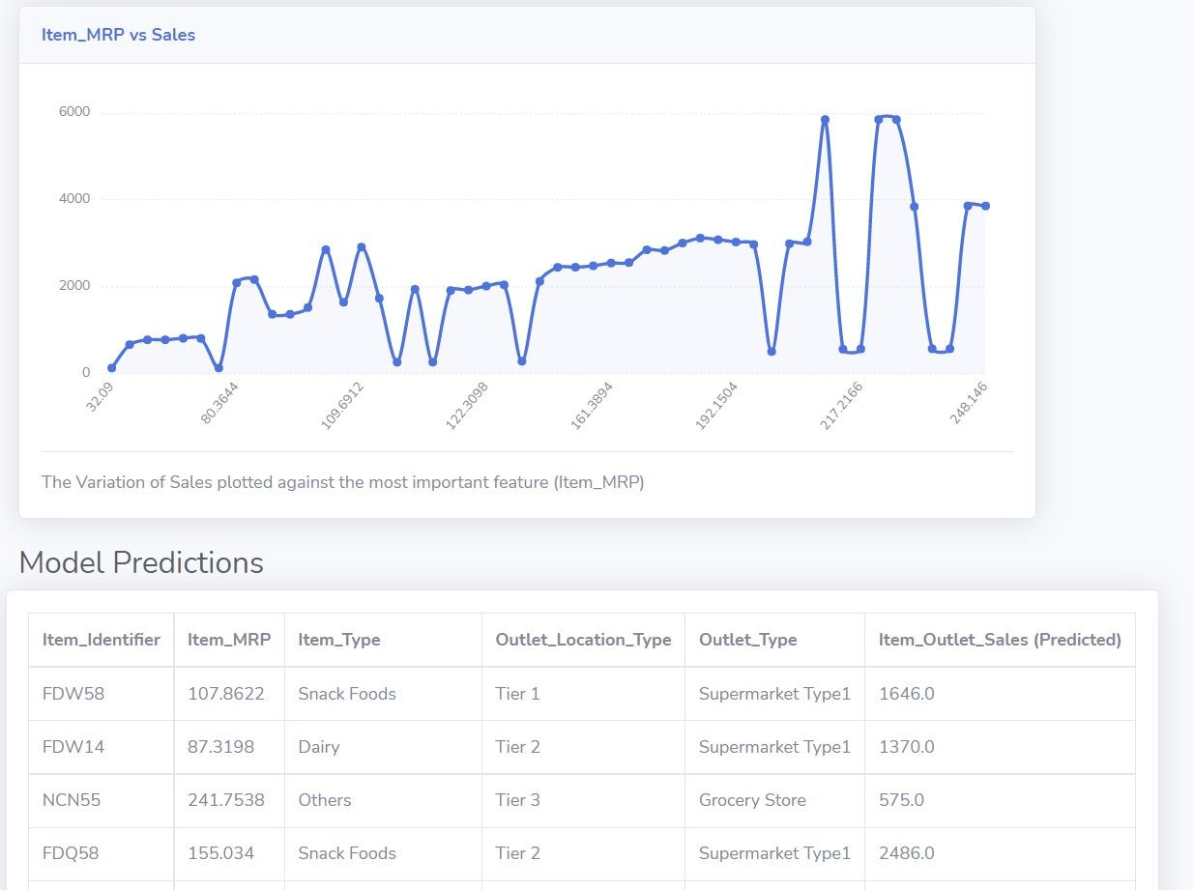
Product Demonstration
Insights generated ii) Variation of Sales (y-axis) with the most important feature (x-axis)

Slide 8
Product Demonstration
Model Predictions

